Slide 1
Exception Handling

Slide 2
Exceptions
Exceptions are unforeseen errors or problems that can occur during the execution of a Python program.
These errors can cause the program to terminate abruptly if not handled properly. Python provides a robust mechanism called "exception handling" to manage such errors gracefully.
ZeroDivisionError,
TypeError,
ValueError,
IOError,
IndexError,
KeyError,
NameError"

Slide 3
Example of Exception
102/0
Open(xyz.txt). //xyz.txt not present in the folder
Int(“Hello”)
date_str = "2023-07-32"
date_obj = datetime.strptime(date_str, "%Y-%m-%d")
ZeroDivisionError
IOError
TypeError
ValueError

Slide 4
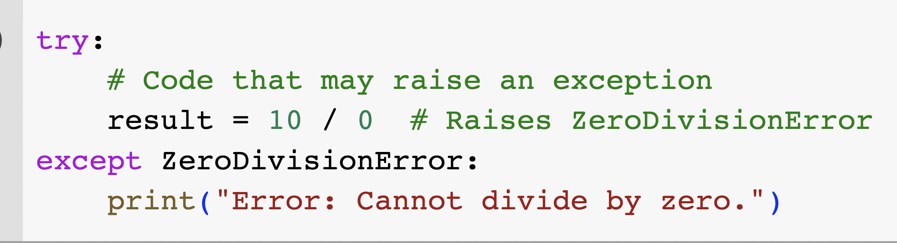
Handling Exception

Slide 5
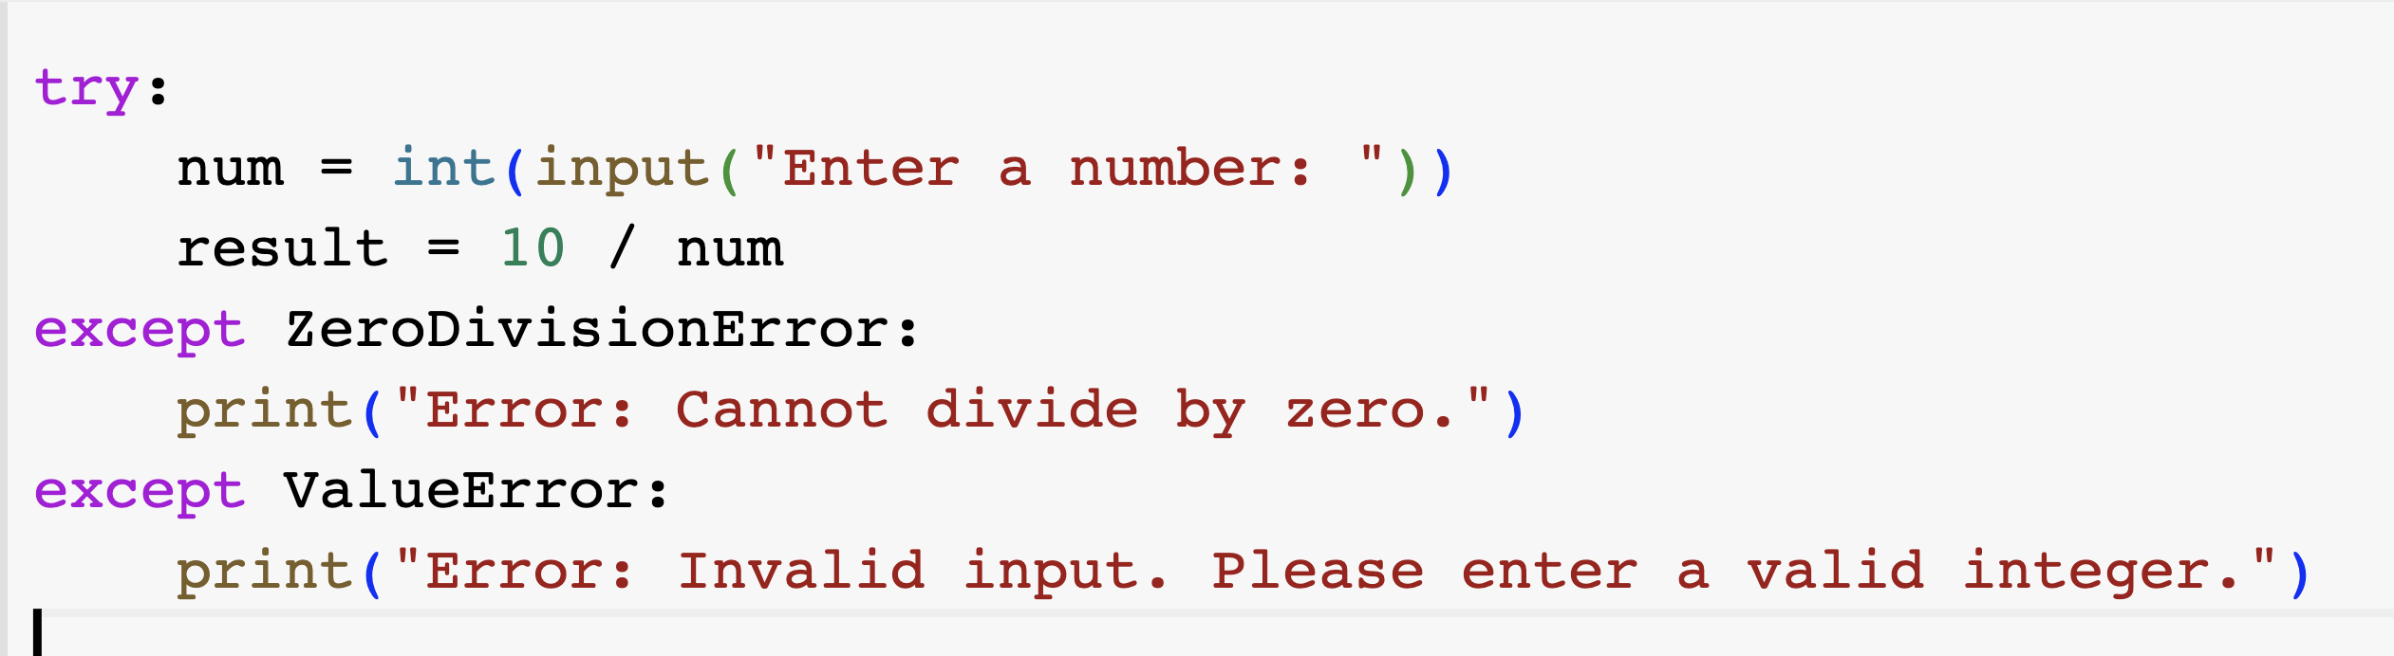
Multiple error possibility

Slide 6
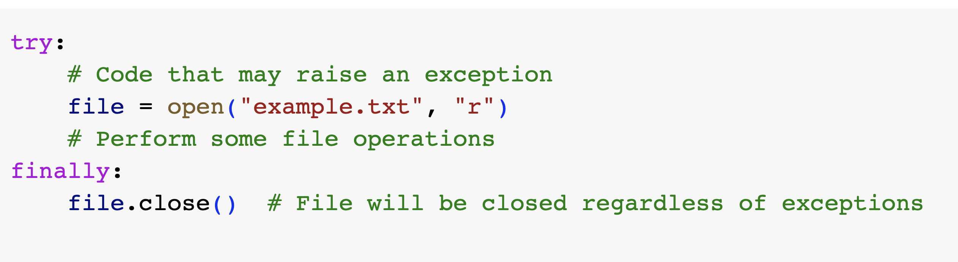
Finally: Something that must execute
The finally block, if present, will always be executed, whether an exception occurs or not.
It is used for cleanup operations like closing files or releasing resources.

Slide 7
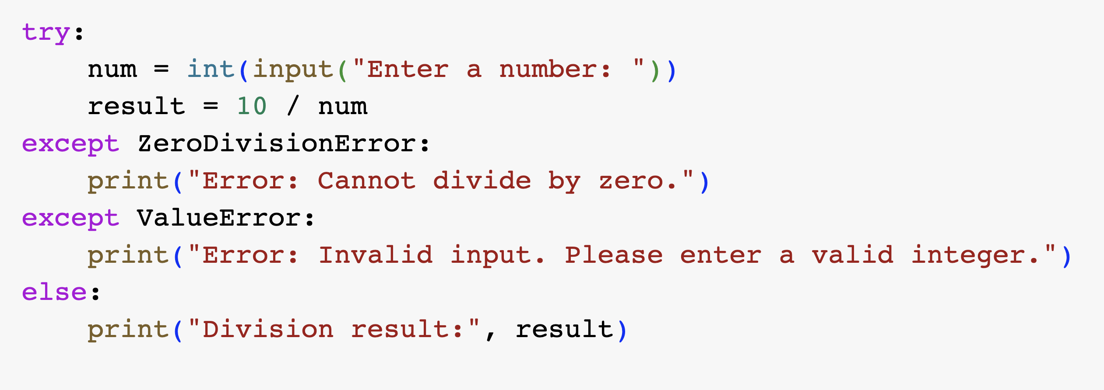
Else clause
The else clause is executed if no exceptions occur inside the try block.
It is typically used to specify code that should be executed when the try block runs without any exceptions.

Slide 8
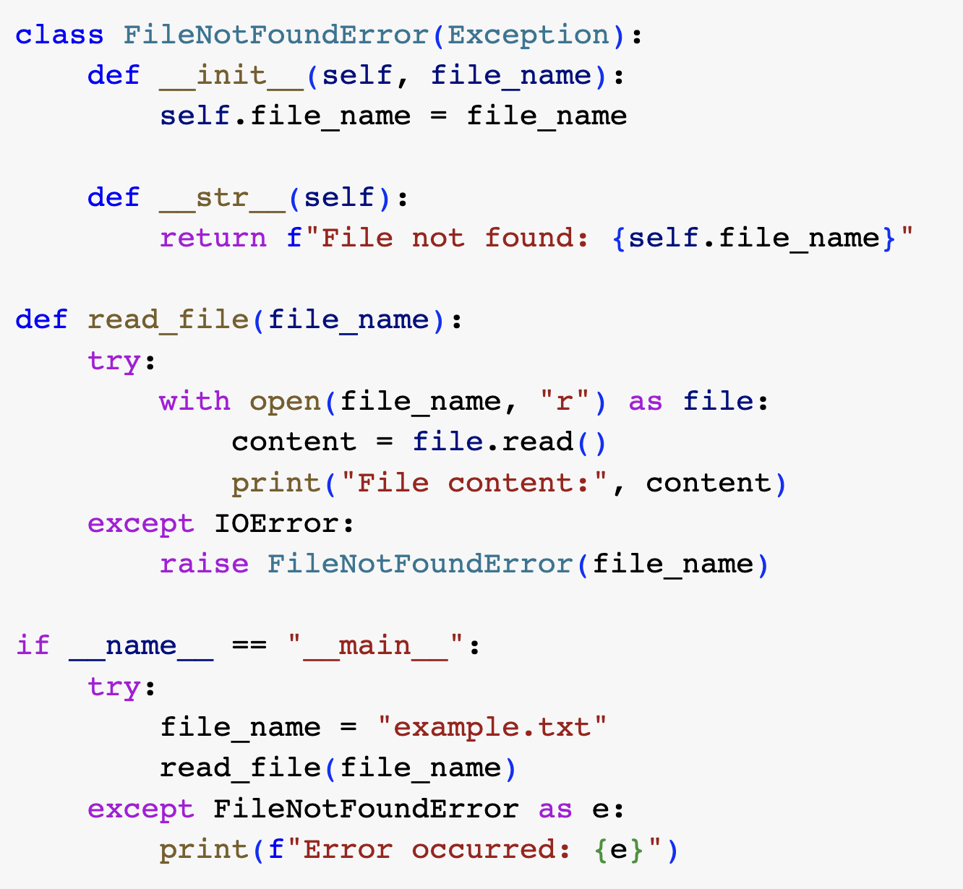
Custom Exception:

Slide 9
Types of Exception
ZeroDivisionError,
TypeError,
ValueError,
IOError,
IndexError,
KeyError,
NameError

Slide 10
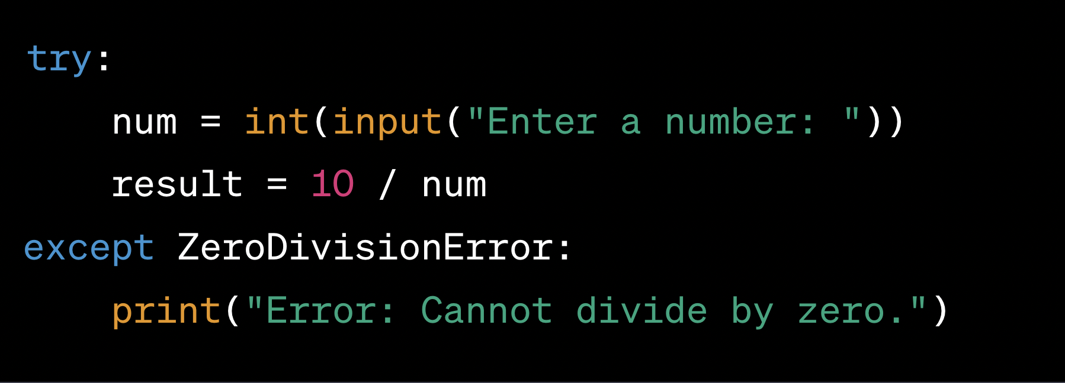
Find Exception type
num = int(input("Enter a number: "))
result = 10 / num

Slide 11
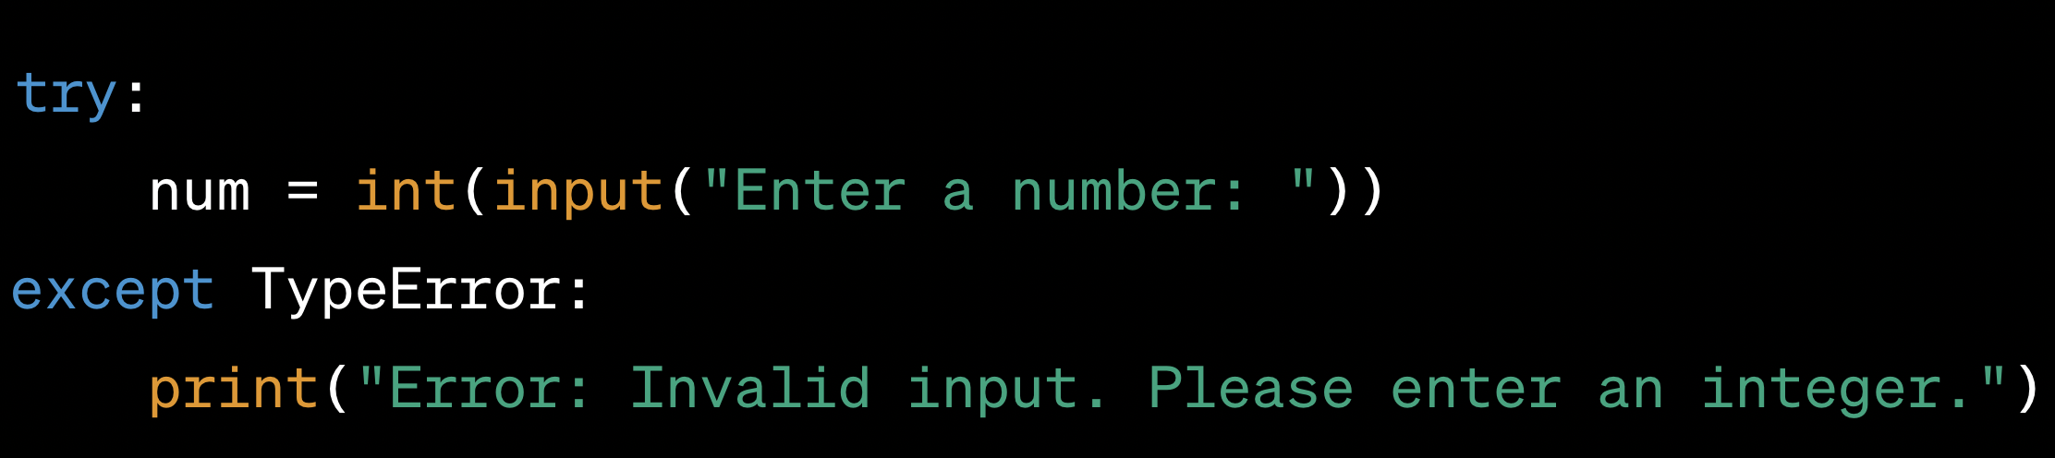
num = int(input("Enter a number: "))

Slide 12
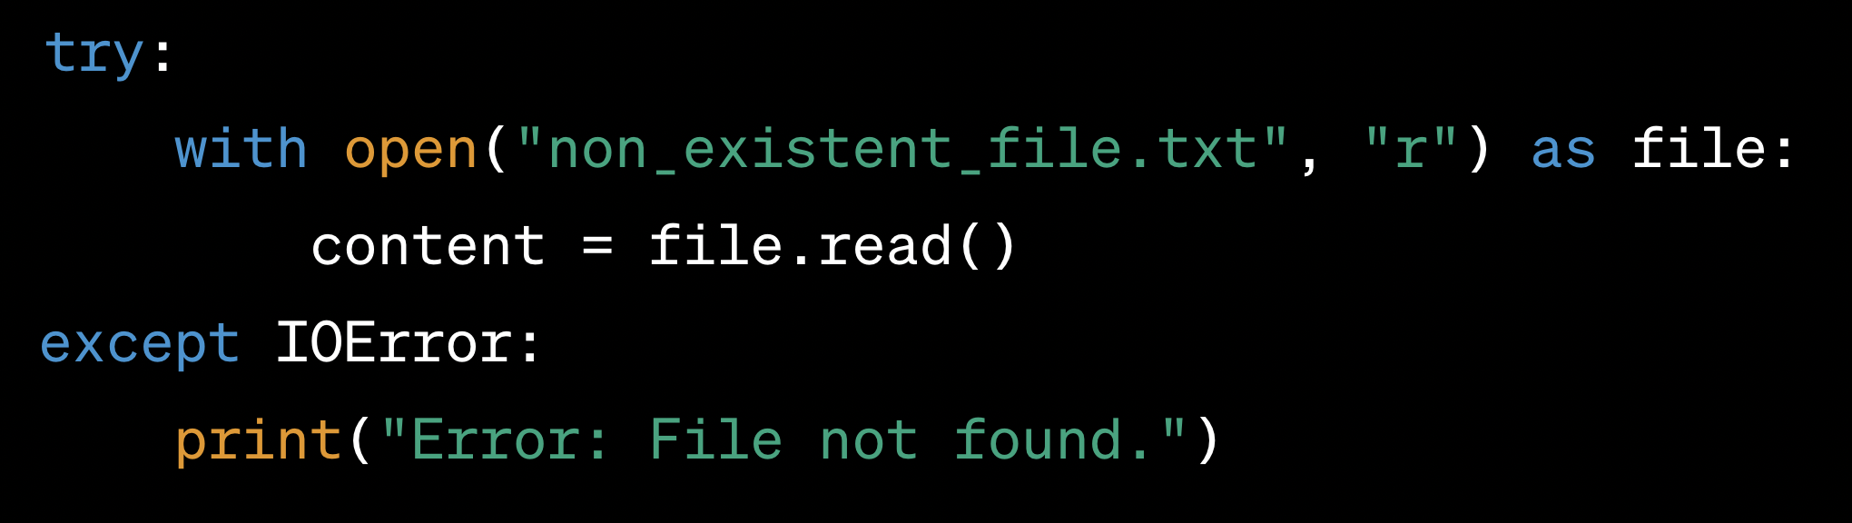
with open("non_existent_file.txt", "r") as file: content = file.read()

Slide 13
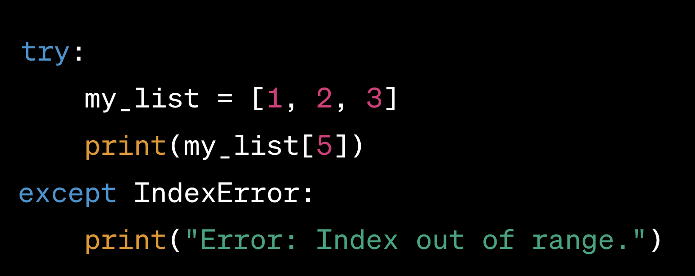
my_list = [1, 2, 3] print(my_list[5])

Slide 14
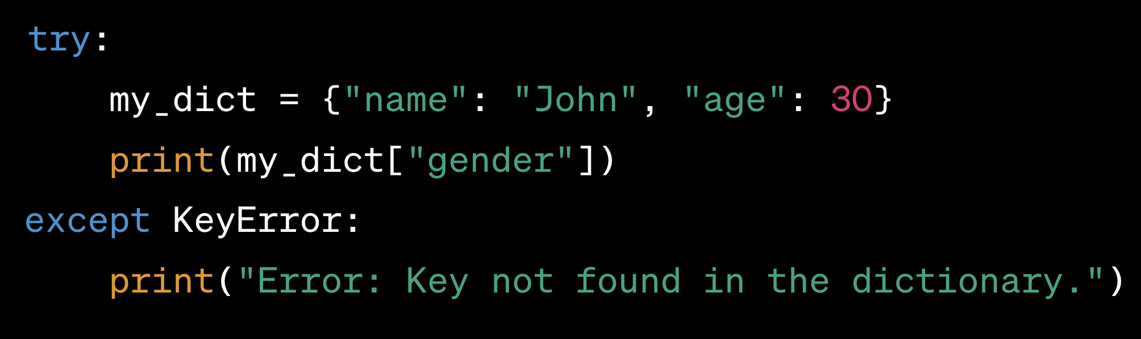
my_dict = {"name": "John", "age": 30} print(my_dict["gender"])

Slide 15
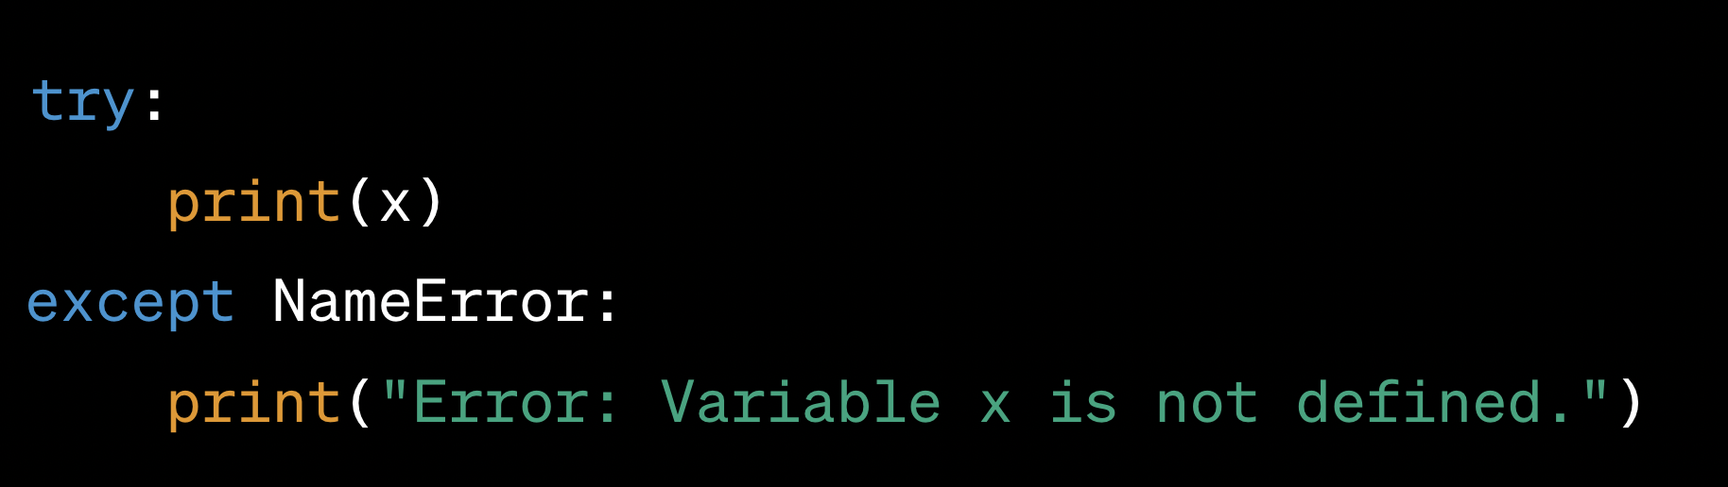
print(x) //x is not defined previously

Slide 16
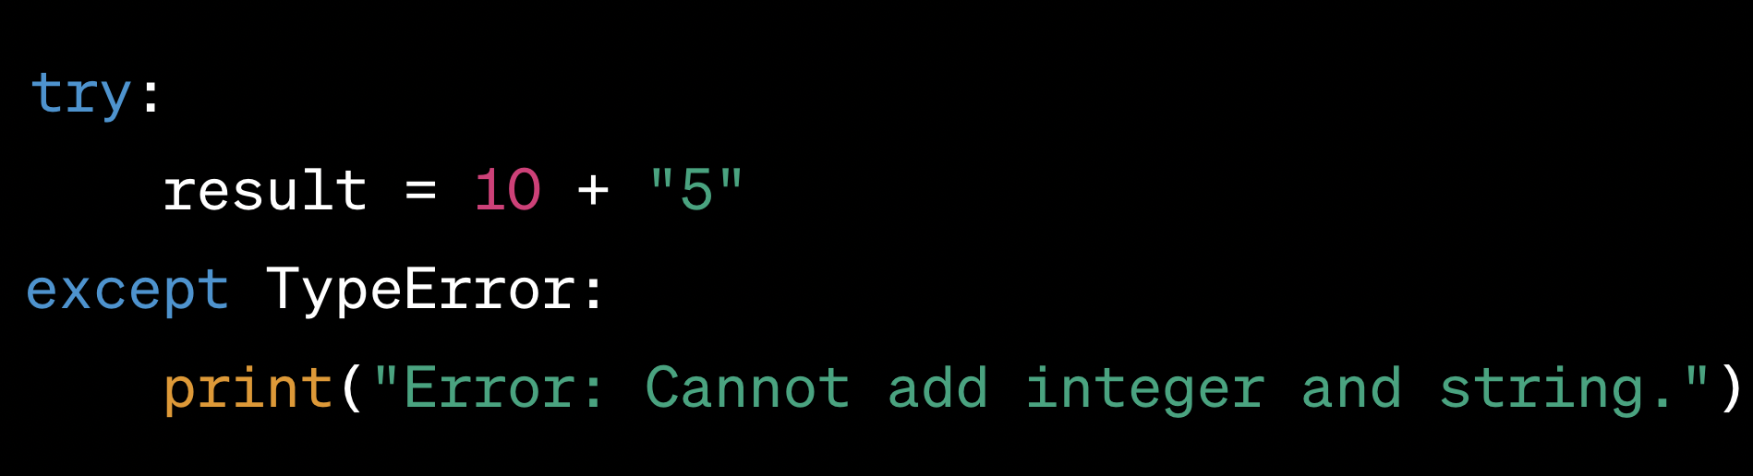
result = 10 + "5"

Slide 17
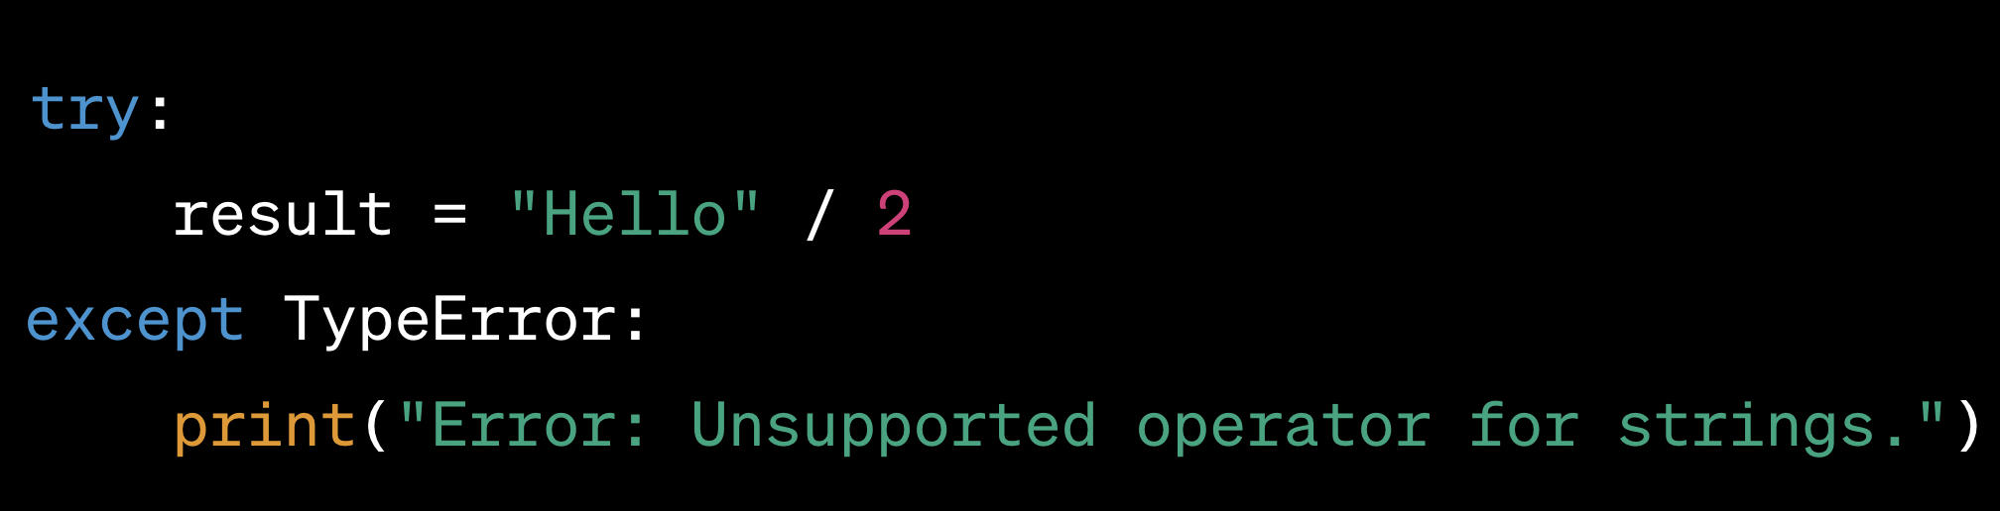
result = "Hello" / 2

Slide 18
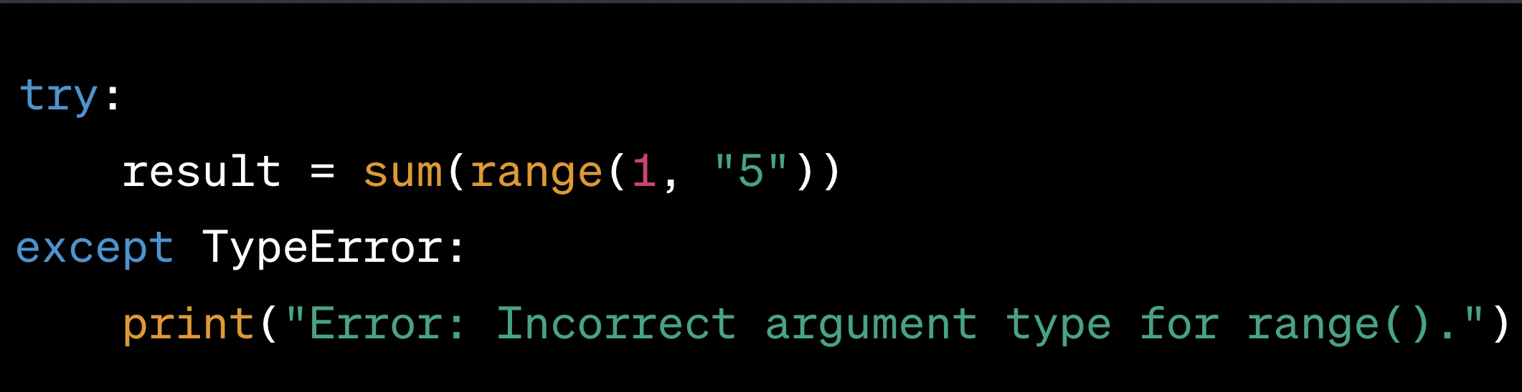
result = sum(range(1, "5")

Slide 19
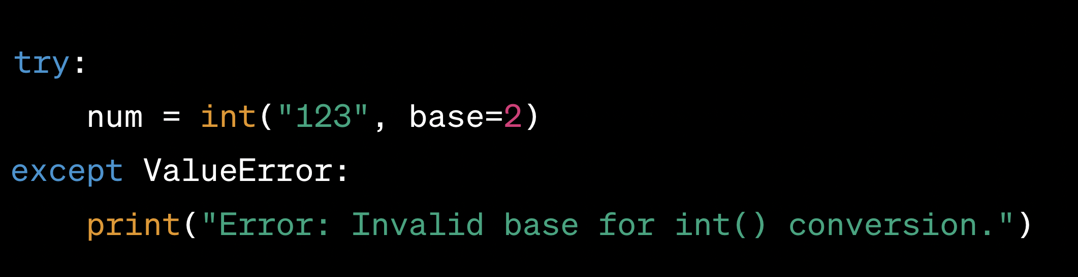
num = int("123", base=2)

Slide 20
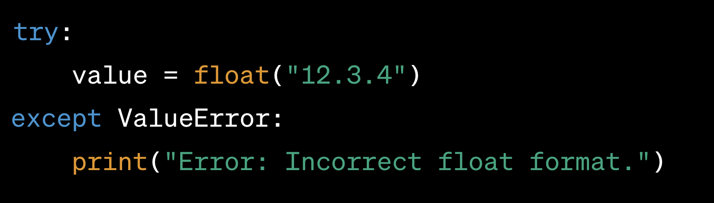
value = float("12.3.4")

Slide 21
Problem
You are working on a project to build a custom text processing tool that reads input from various sources, processes the text data, and stores the results in an output file. As part of this project, you need to implement a robust exception handling mechanism to handle potential errors that may arise during the text processing.
The tool needs to perform the following steps:
Read the input data from a file specified by the user.
Process the text data by performing various operations, such as counting words, calculating character frequencies, and generating word clouds.
Store the processed results in an output file.

Slide 22
Task
Your task is to design a Python program that incorporates appropriate exception handling to handle the following situations:
File Not Found Error: If the user provides an invalid file path or the input file is not found, your program should raise a custom exception FileNotFoundError with a suitable error message.
Invalid Input Data: During text processing, if any unexpected input data is encountered (e.g., non-string values or missing data), your program should raise a custom exception InvalidInputDataError with relevant details.
Disk Space Full: If the output file cannot be written due to insufficient disk space, your program should raise a custom exception DiskSpaceFullError

Slide 23
Additionally
You can use Python's built-in modules, such as os for file handling and logging for logging exceptions
The program should have the following features:
The custom exception classes should inherit from the base Exception class and provide meaningful error messages.
Proper logging should be implemented to capture details about the exceptions that occur during text processing.
The program should provide a user-friendly interface, allowing the user to enter the input file path and choose the desired text processing operations.
The processed results should be stored in an output file with a suitable format (e.g., JSON, CSV, or plain text).

